Slide 1
Huntington’s Disease Biomarkers: Peripheral Blood Gene Expression Profiling
Samantha Hartner

Slide 2
Introduction
HD is progressive neurodegenerative autosomal dominant condition
Biomarkers of disease from early progression to disease onset can increase understanding of disease and help with assessment in clinical trials
My study used mRNA assay to profile peripheral blood biomarkers
Huntington’s Disease affects the CNS, but the mutant Huntingtin protein is found throughout the body, meaning biomarkers for the disease may be found in other tissues
31 samples in 3 groups:
12 symptomatic HD patients
5 pre-symptomatic HD patients
14 control patients

Slide 3
Methods
My Analysis Steps:
GEO2R Analysis from Affymetrix GeneChip
Log2 transformation and t-test
Select top 322 Genes
Principal Component Analysis (PCA)
Kmeans Clustering
Pathway Analysis
Panther
Reactome
KEGG
Original Authors’ Analysis:
Analysis of Affymetrix (Mas5) and Amersham (CodeLink) microarrays
Filtering to reduce technical noise
Normalization (Spotfire)
Two-sided t-test (Excel)
Ratio of change calculation (Excel)
PCA (S-Plus)
Hierarchical clustering (Spotfire)
QRT-PCR of top 30

Slide 4
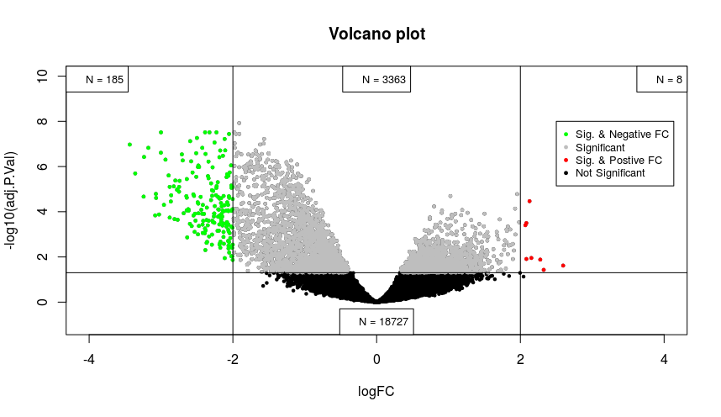
Volcano Plot - all genes

Slide 5
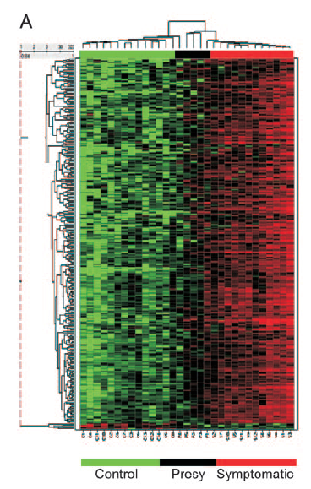
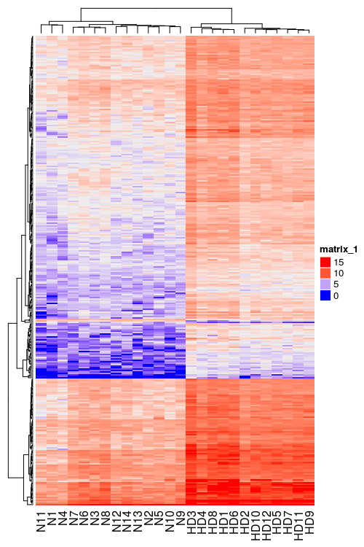
Heatmap

Slide 6
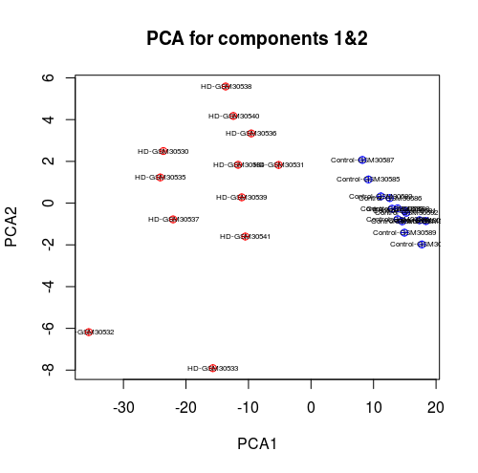
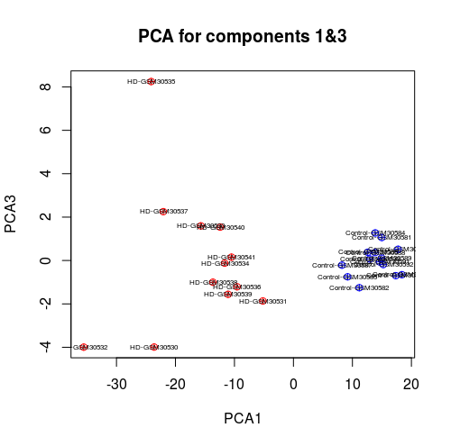
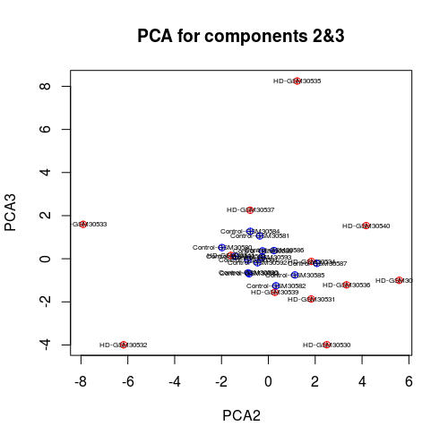
Principal Component Analysis

Slide 7

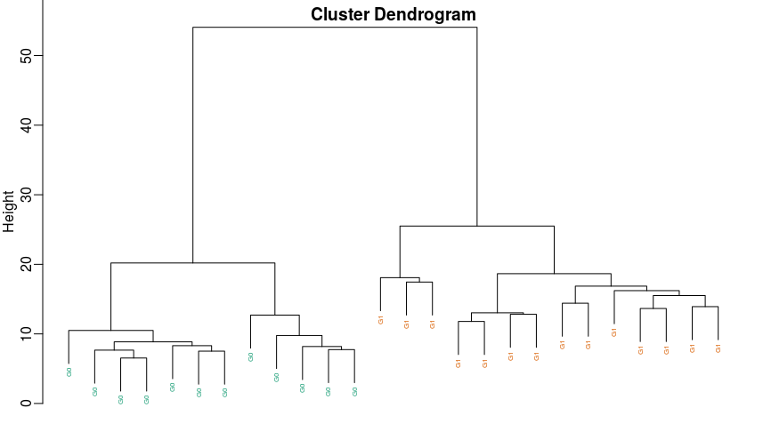
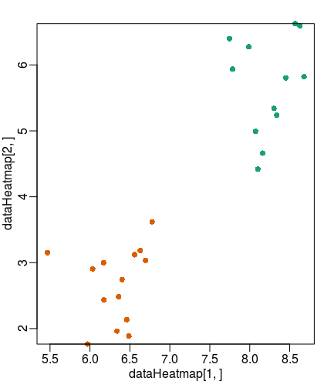
k means Clustering

Slide 8
Most Differentially Expressed Genes
Of the 322 genes analyzed by GEO2R, I took a subset of genes with p < 0.05 and absolute logFC > 2
n = 81
ANXA1
AX0T
CAPZA1
HIF1A
JJAZ1
P2Y5
PCNP**
ROCK1
SF3B1
SP3**
TAF7
YIPPEE

Slide 9
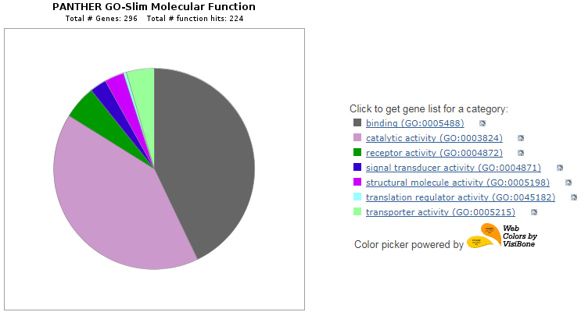
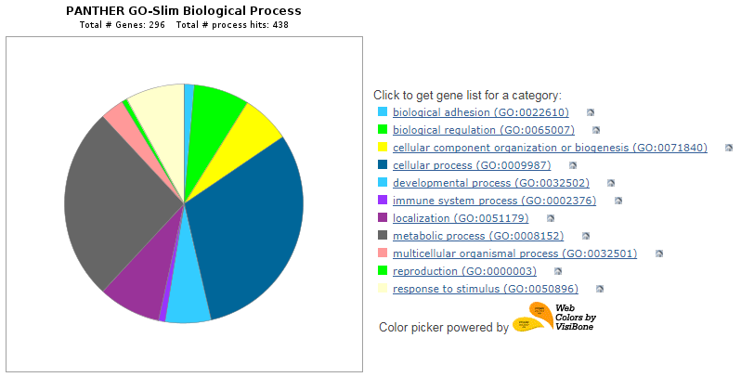
Pathways
Pathways Identified in Paper:
Transcription/RNA processing
Signaling
Ubiquitin/proteasome
Vesicle trafficking

Slide 10
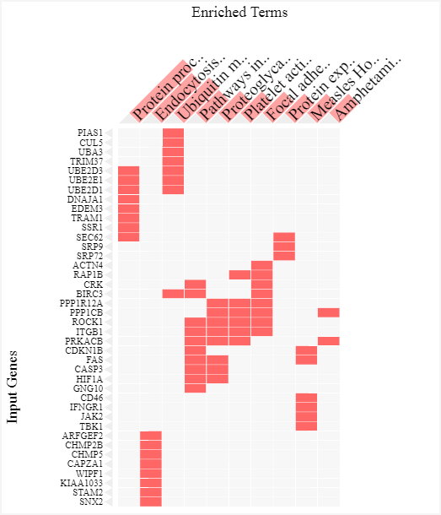
Pathway Analysis - KEGG

Slide 11
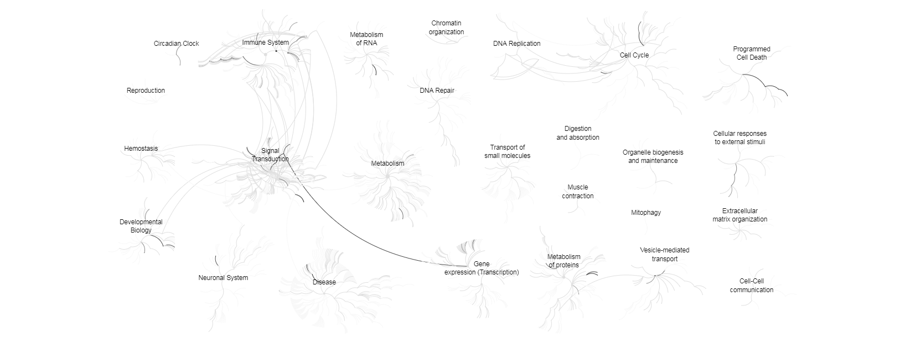
Pathway Analysis - Reactome

Slide 12
References
Borovecki F, Lovrecic, L, Zhou, J, Jeong, H et al. Genome-wide expression profiling of human blood reveals biomarkers for Huntington’s disease. Proc Natl Acad Sci U S A 2005 Aug 2; 102(31):11023-8. PMID: 16043692
https://www.ncbi.nlm.nih.gov/geo/geo2r/

